Slide 1



Introduction to
OpenLink and Endur
Endur Training
Notes:
Welcome
Introductions
Ice breaker
Logistics – Breaks – Lunch – Question time

Slide 2
INTRODUCTION TO ENDUR
Our Aim for today:
To provide an overview of OpenLink Endur processes, terminology and key functionality

Slide 3
Overview of Endur

Slide 4
Overview of Endur
Front Office
Main functions:
Trading
Back
Office
Middle
Office
Transactions
Operations Processes
Risk Management
Notes:
OpenLink Endur is a front- to back-office trading and risk management tool. It combines a service-based architecture with a client-server environment to value a variety of instruments in the energy and electricity markets. The system is supported on Windows NT and UNIX operating systems and offers multiple database platforms (including Sybase and SQL Server). Endur’s Main functions are within the front, middle & back office.
These functions encompass the following:
FO – trading processes e.g. deal capture, simulations etc
MO – risk management e.g.
BO – operations processing e.g. accounting processes, confirmations and other document management processes etc,

Slide 5
Overview of Endur Front Office
Front Office
Enter trades
Price Trades
Revalue portfolios
Run scenario reports
View position reports
Middle
Office
Trading
Back
Office
Transactions
Operations Services
Risk Management
Notes:
Trade entry & deal booking
Trade pricing
Position Management
Portfolio revaluation & simulations – MTM
Enter transactions into system
Profit making (Investment Banks)
Providing for needs of company (Utilities)
Selling products of company (Energy Producers)
Liquidity/Funding Providers (Central Banks)
Hedging (Trading Company)
Take advantage of market conditions/opportunities
Service clients
Adhere to risk limits/positions
Monitor the value of your books

Slide 6
Overview of Endur Middle Office
Front Office
Monitor credit & market risks
Revalue portfolios
Run scenarios
Position and Price Analysis
VaR
Trading
Back
Office
Middle
Office
Transactions
Operations Services
Risk Management
Notes:
Credit & market risk monitoring
Portfolio revaluation & simulations
Regulatory Reporting/Compliance
Capital Requirements (banking)
Investigate suspicious activity
Look at what-if scenarios
Monitor and control risk
Credit
Market
Operational

Slide 7
Overview of Endur Back Office
Front Office
Price fixings
Generate confirmations & invoices
Document management
Generate reports
Account postings
Trading
Back
Office
Middle
Office
Transactions
Operations Services
Risk Management
Notes:
Confirmations & invoicing
Prices and rates fixed for deals
Reports generated
Support the front office
Maintaining static data
Deal enrichment
Controls and audit
Funding requirements
Making payments/deliveries
Confirming with counterparties
Maintain official prices
Fixings
Controlling/setting up workflows
Scheduling
Accounting

Slide 8
Overview of Endur Front-Mid-Back
Front
Office
Middle
Office
Back
Office

Slide 9
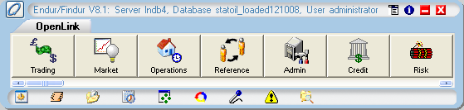
Overview of Endur OpenLink Central
This is the central point for accessing all Endur Managers – One-Click Access
Standard View
Notes:
OpenLink Central is the master console that contains icons for the system functions (managers). After logging in to the system, the OpenLink Central panel appears. The icons represent the functions that users access specific to their job roles.
Endur has 8 managers
Each manager is run as a separate module with its own functions
Essential to understand interaction between managers
Access Server and Database Information
This view can be configured to suit the user in the Edit configuration screen.
Favorites items are located in the lower portion of OpenLink Central . Contains commonly used icons that can be established as Favorites. Favorites are set up through OpenLink Central’s Configuration function.

Slide 10

Reference Manager
Maintains internal & external party information:
Parties
Party Groups
Business units
Legal entities
Portfolios
Personnel
Remember the 3Ps!!

Slide 11

Admin Manager
Performs multiple administrative tasks
Static Data set-up
Security Administration
Data Model Extension
Notes:
Multiple Admin Tasks
System configuration
Maintenance of static data
Security privileges
Data Model Extension
Static Data set-up
System wide configuration
Holiday calendars
Unit conversion
Pipeline/grid systems
Energy quality measures
Security Administration
Users are set up in the Reference Manager
Security groups are set up in the Admin Manager
Security privileges are assigned in the Admin Manager
Data Model Extension
Custom user-defined fields applied to:
Transactions - customized reference fields for use with trade
Parties, Personnel - customized ref fields for use with party groups/legal entities/business units, int or ext.
Subledger Accounts - create customized fields for use in accounting manager – text entry or picklists
Party Agreements - customized ref fields for each document associated with an int/ext bu or le
Market Curves

Slide 12

Market Manager
Defines curve/index structure:
Financial market curves
Valuation Curves
Market data
Prices
Rates
Volatility & correlation matrices

Slide 13

Trading Manager
Captures deals
Retrieve & view existing trades
Run & view reports
Performs on-the-fly simulations
Revalue portfolios
Position Management

Slide 14


Credit & Risk Managers
Monitors credit & risk limits through user-defined credit & risk calculations
Credit Manager
Check external exposures
Risk Manager
Check internal exposures

Slide 15

Operations Manager
Performs multiple trade administration & back office tasks
Settlements and Confirmation
Document Management
Instrument Fixings
Options Exercise
Automation
Notes:
Performs multiple trade administration & back office tasks:
Trade validation
Option Exercise
Settlements
Confirmations
Price fixings
Define automated checks and STP rules
Settlements Desktop - Settlement and Confirmation ++
Create and Manage Documents:
Preferred output method
Information/data required
Deal/event grouping
Workflow and statuses
Automation
Pre- and Post- processing
Services Manager – workflows and EOD
STP
Credit/Risk/RTP Engines

Slide 16

Accounting Manager
Generates accounting data from transactions
Extract and insert information into appropriate accounts at the appropriate time, based on event criteria
Accounting Manager provides the mechanism to answer questions about when/What/Where to make a posting
Notes:
Generates accounting data from transactions:
Chart of accounts
Posting rules
Subledger entries
Subledger balances
To extract information from the database & insert it into the appropriate account at the appropriate time
To do this we must answer these questions:
WHEN do you wish to make a posting?
WHAT value do you wish to be posted?
WHERE, to which account, do you wish to post?
Accounting Manager provides the mechanism to answer these questions

Slide 17
Endur Managers
Admin Manager:
Global administrative data (i.e., static data maintenance, security privileges, network grids)
Reference Manager:
Counterparty and internal entities’ information, personnel, broker fees structure, agreements, settlement terms
Trading Manager:
Trade Blotter
(Deal Entry)
Trading Manager:
Master instrument - sharable toolset, templates - unique toolset
Market Manager:
Market curves and volatilities, historical prices
Commit to a preliminary status
Credit Manager:
Credit check (credit line & credit rating)
Risk Manager:
Market risk check (risk lines)
Back office validation
“Validation”
of
Deal Terms
Operations Manager:
Events generated
Accounting Manager:
P&L
Confirm
Settle
Rate fixings
Reset Notifications
Matured
Notes:
Endur Managers Represents functions that you can perform within the system.
Trading Manager
Master instruments
Sharables
Trade entry blotters/Trader Desktop
Templates for uniques
Admin Manager
Global system set-up
Static data maintenance
Security privileges Client Data modelling – Tran Info, Ins Info, Party Info, Personnel Info
Reference Manager
Book structure – info, broker fee structure, settlement terms, agreements, etc
Personnel – portfolios, security privileges
Credit & Risk Managers
Check counterparty credit limit
Market risk e.g. MTM, trader limits
Operations Manager
Mini-modules controlling transaction events

Slide 18
Any Questions ?
Notes:
Recap – Endur has 8 managers split into 3 areas within which the user can perform various functions.
Three areas – Front, Middle, Back
So far we have:
Introduced Endur system
Briefly described each manager in scope– Please note that there are also other managers such as services manager which is outside the scope of this training course
Discussed interaction & relationships between managers

Slide 19
Overview of Endur Common System Functionality
Notes:
We will look at:
The browser
Time/Date conventions and Amount Conventions
The Table Viewer

Slide 20
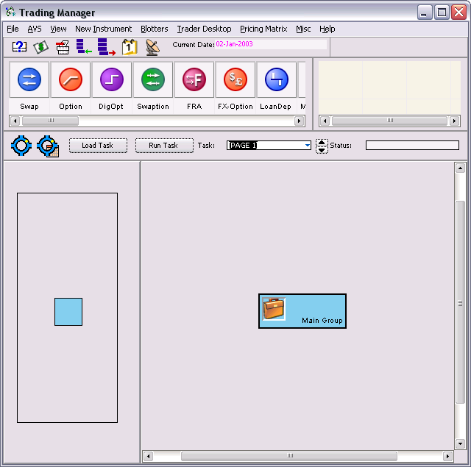
Browser Window
A- Before Query
Notes:
The Browser Window is a graphical depiction of the results of a query.
The Browser Window functionality is consistent across the Endur system.
It is available in applications such as the Reference Manager, Trading Manager, Market Manager and Accounting Manager.
Screen shot A displays the Trading Manager prior to running a query. Screen shot B displays the result of a query in the Browser Window that has been run for all Validated ComSwap deals

Slide 21
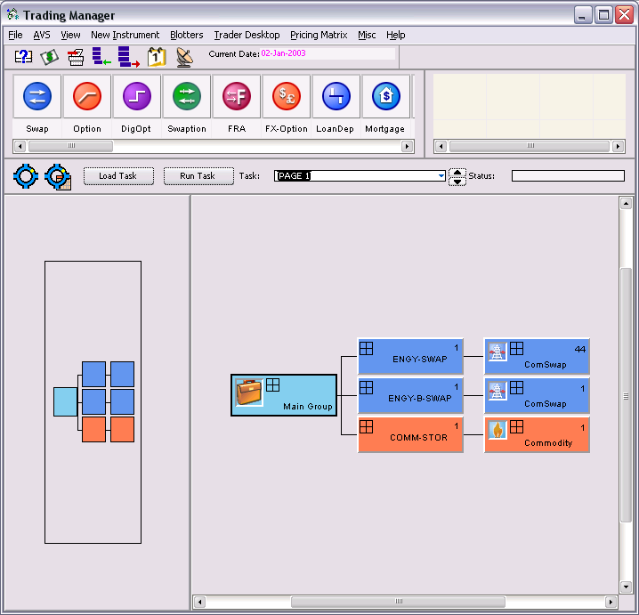
Browser Window and Queries
The Browser displays the results of a query in graphical form:
B - After Query
Notes:
Why do we use queries? – to interrogate the database to retrieve information/data
When “querying” a database, the user specifies the criteria to search for. The system searches the database for the fields and values requested, and returns those results in a Browser Window view.
An example would be when a trader is searching their “book” for a list of all New deals, as in the above screen shot B.

Slide 22
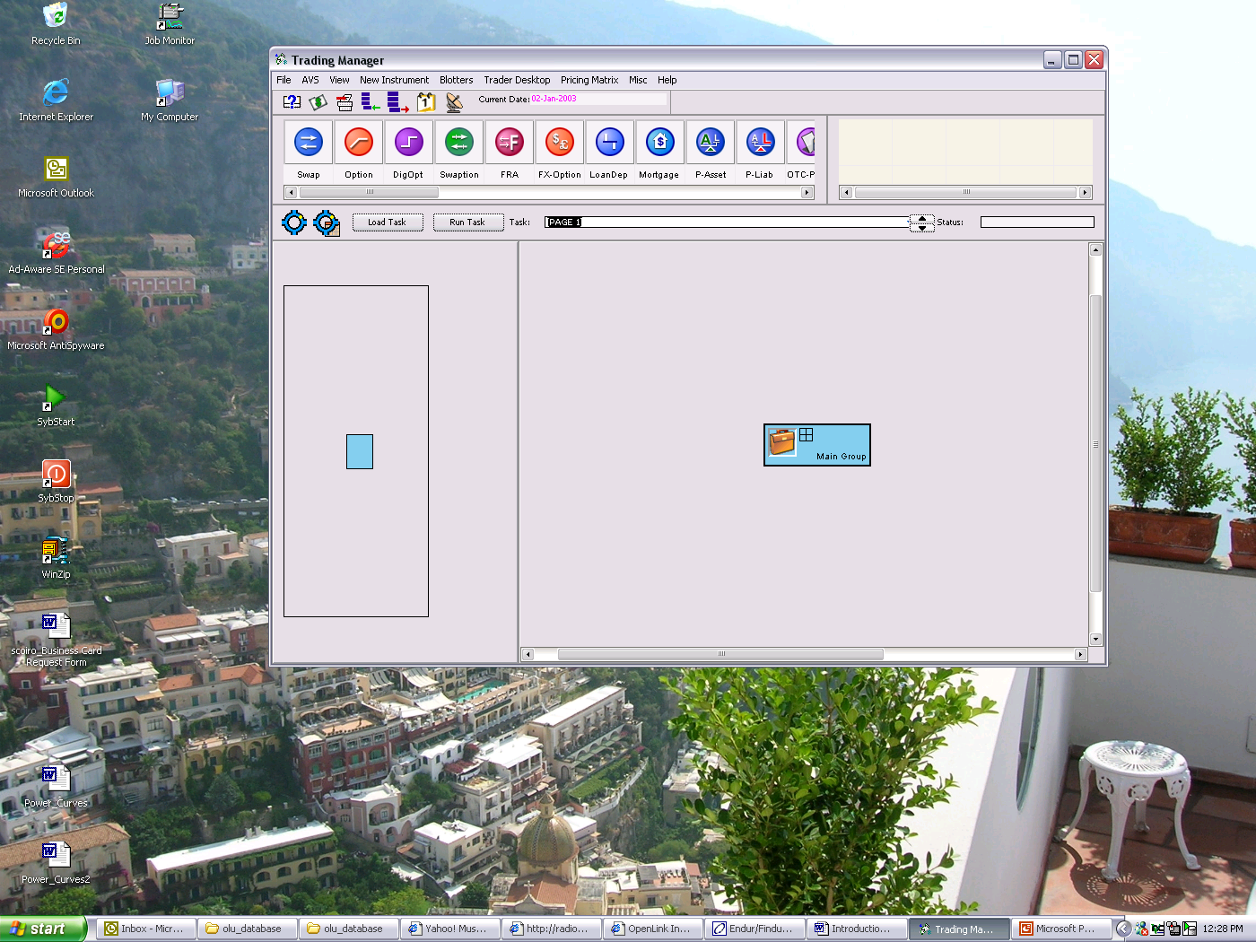
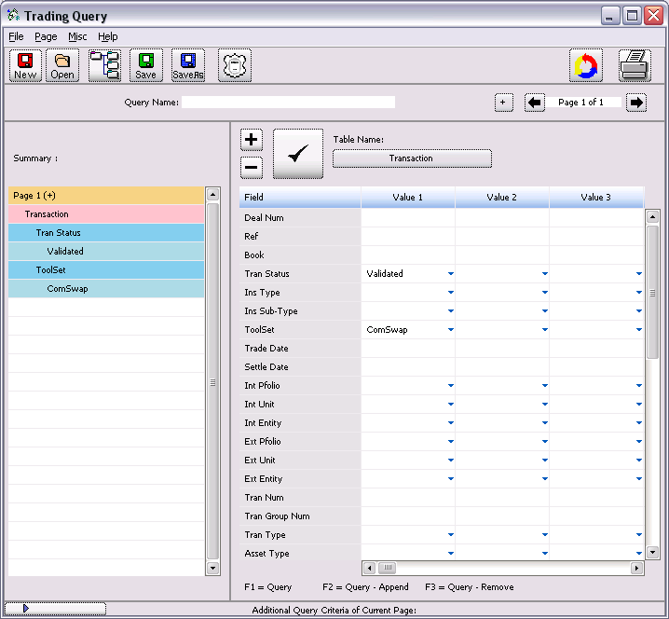
Accessing the query functionality
The Query Manager is accessed by selecting the Query icon located on the tool bar, or by selecting File→Query from the Manager menu bar.
Notes:
How do we use queries in the system?
Click icon or File-Query
The query Window pops up

Slide 23
Running a Query
As criteria are entered, the left side of the screen displays a summary of all criteria.
Search criteria are specified in the right side of the page.
Conditional operators:
< (less than)
> (greater than)
= (equal to)
<= (less than or equal to)
>= (greater than or equal to)
! (not)
Notes:
Explain that data is stored in tables.
Example – A Trading Manager query
A query consists of specifying the Table(s), Field(s) and Value(s). A user may request information from more than one table pertaining to the Manager in which the user is running the query. Within the table, the user may specify value(s) for one or more fields of information.
In this scenario, the user is searching for all Validated ComSwap deals.
Click the check mark ✓or select <F1> to execute the query. The query results display in the Browser window format as discussed on the previous page.

Slide 24
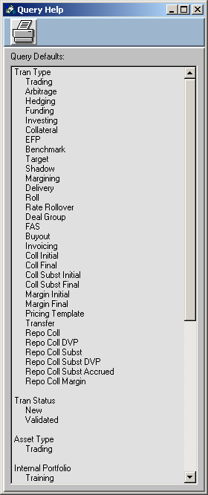
Query Defaults
Automatically applies default criteria to reduce database processing
Navigate to defaults via the help menu
Can overwrite the default settings in query window
Selects transactions types listed under Tran Type
Only transactions with new or validated Tran Status & Trading Asset Type
Only portfolios that you are authorised to use under Internal Portfolio
Notes:
Note to class that we did not specify that the query should return validated deals – This is because by default the system will return validated deals. If you require deals in other statuses such as New, Pending etc, then you must specify this.

Slide 25
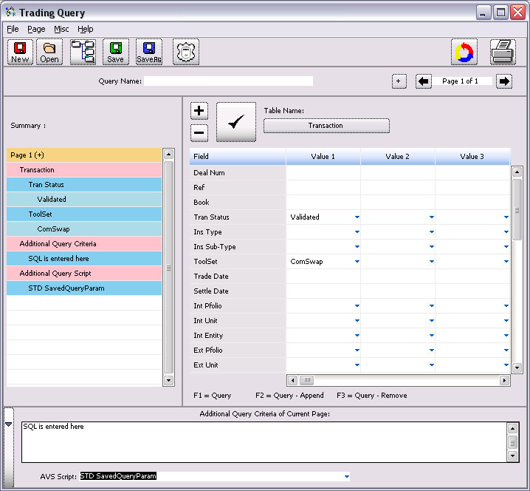
Additional query criteria - SQL
Click the drop down arrow located on the far left-hand corner of the Query window. A separate window displays. This is a free-format field where the SQL can be entered.
Type the SQL in the field provided on the right. Click the check mark to run the query.
Notes:
Additional query criteria that are currently not available in the pick lists may be added using SQL or AVS scripts.
Click the drop down arrow located on the far left-hand corner of the Query window. A separate window displays. This is a free-format field where the SQL can be entered.
Type the SQL in the field provided on the right. Click the check mark to run the query.

Slide 26
Time Period & Amount Conventions
Use time period shortcuts to query on a range of dates
d for days
w for weeks
m for months
y for years
Use amount shortcuts to insert trailing 000’s on numbers
k for thousand
m for million
Mix & match with conditional operators
e.g. 5d = 5 days
e.g. 3k = 3’000
e.g. >5d = greater than 5 days
Notes:
These are effectively shortcuts.

Slide 27
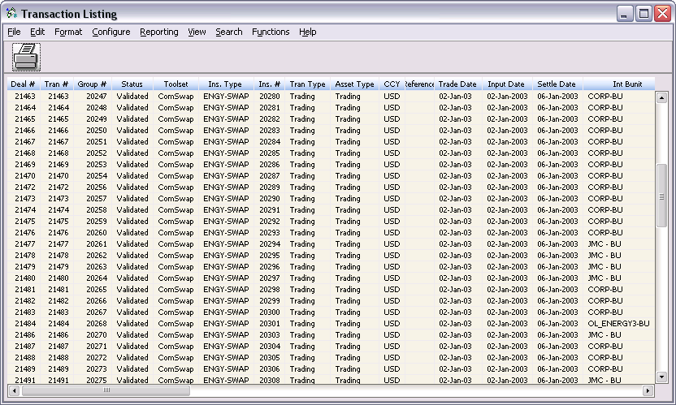
Table Viewer
Used to display list of data
Functionality consistent throughout system
Can modify table structure
Notes:
Several modules within the system use the Table Viewer to display data. The Table Viewer is a listing of information. You may modify the table setup (i.e. sort, filter, sum, and group sum). The table contains data fields (columns) and data records (rows).
To access the Table Viewer:
Run a query. Once the query results display, hold your mouse over the four boxes on the query nodes until it changes to a piece of paper.
Left click the box to launch the table.
To sort or filter the Table Viewer:
Right-click a blue column heading to sort or filter by that column. A separate menu displays.
Select Sort Ascending or Sort Descending to sort the table by the column, or Filter Col to limit the selection criteria. An example would be to sort the transaction list results by Trade Date descending.

Slide 28
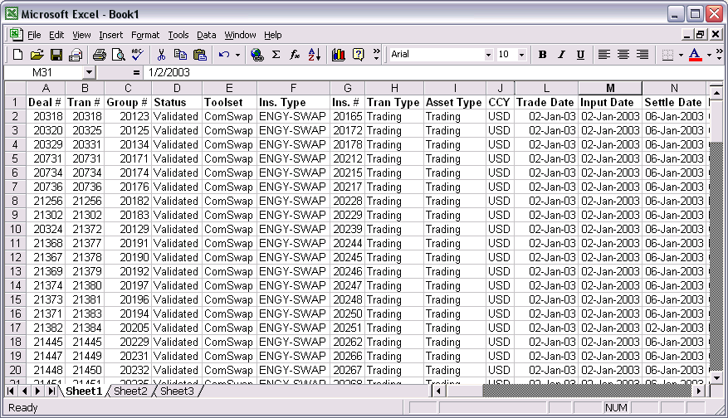
Exporting Table Viewer Data into an Excel Spreadsheet
Table Viewer – Export Data
Notes:
Exporting Table Viewer Data into an Excel Spreadsheet:
Users have the ability to export data from the Table Viewer directly into an MS Excel Spreadsheet.
Select Reporting → MS Excel from the Table Viewer menu bar. The Excel Interface window displays.
Select either Export to New Workbook, Export to Open Workbook, Export to Existing File, and click <OK>. Excel will open as a separate window, and the data from the Transaction Listing table is automatically formatted within an Excel worksheet.

Slide 29
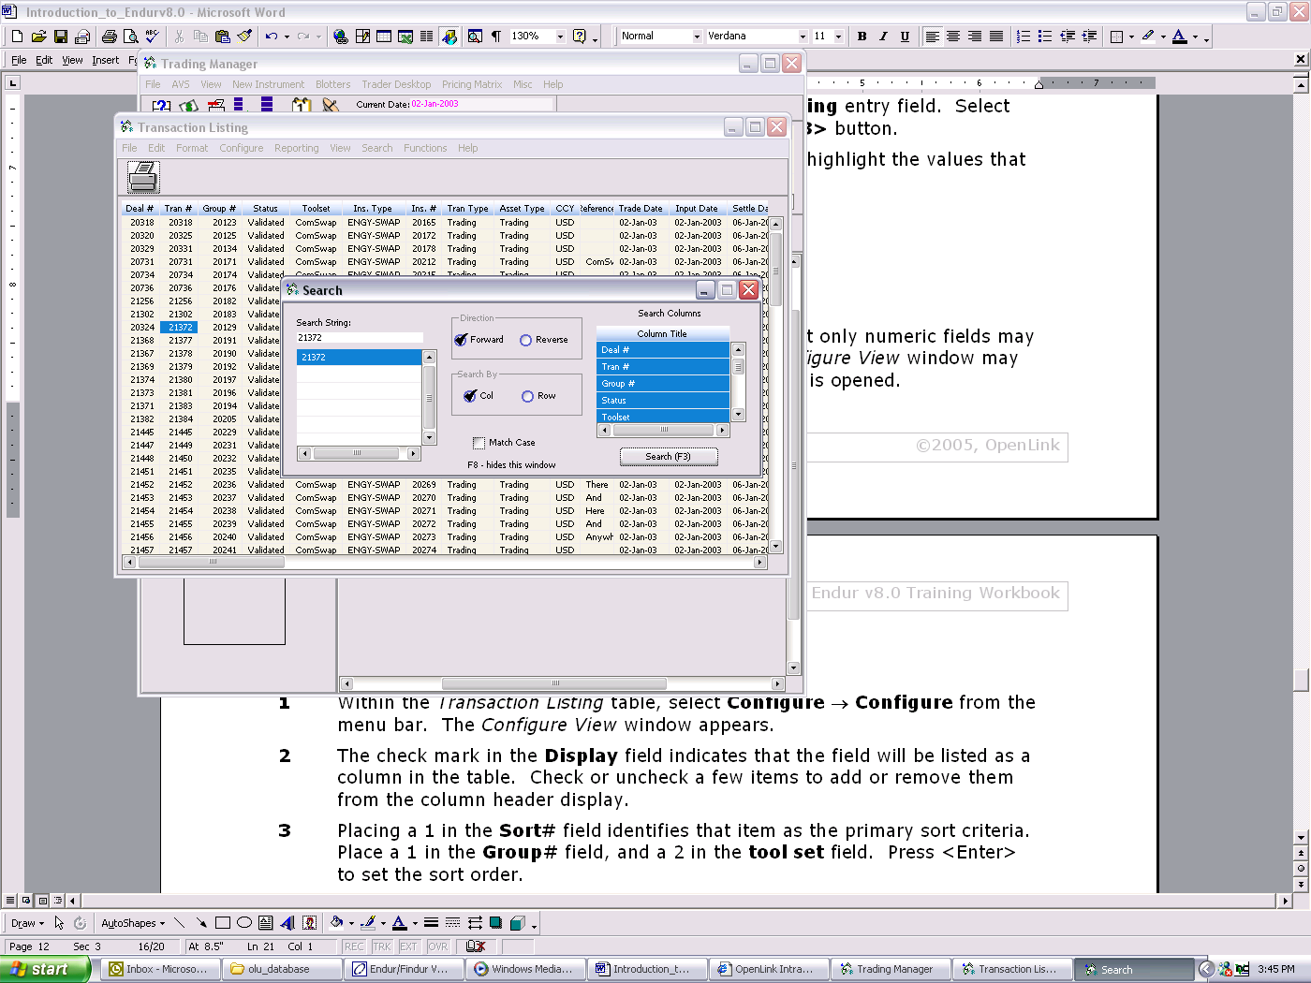
Searching the Table Viewer
Notes:
Searching the Table Viewer for specific data fields:
The Search feature helps users identify a specific value within the lines of data listed in the Table Viewer.
Select Search from the Table Viewer menu bar, or select <F3>. Both functions generate the Search Window.
Enter the word or group of words in the Search String entry field. Select <Enter> on your keyboard, or click the Search <F3> button.
The system will move through the lines of data and highlight the values that match your search string. In the example below we searched for Tran# 21372.

Slide 30
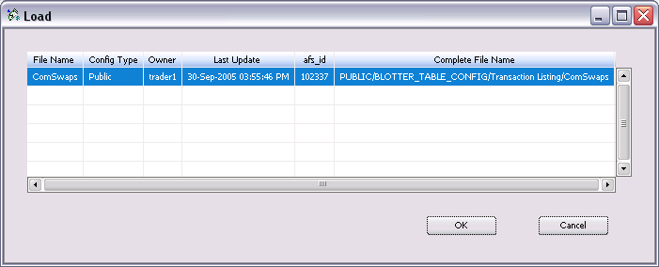
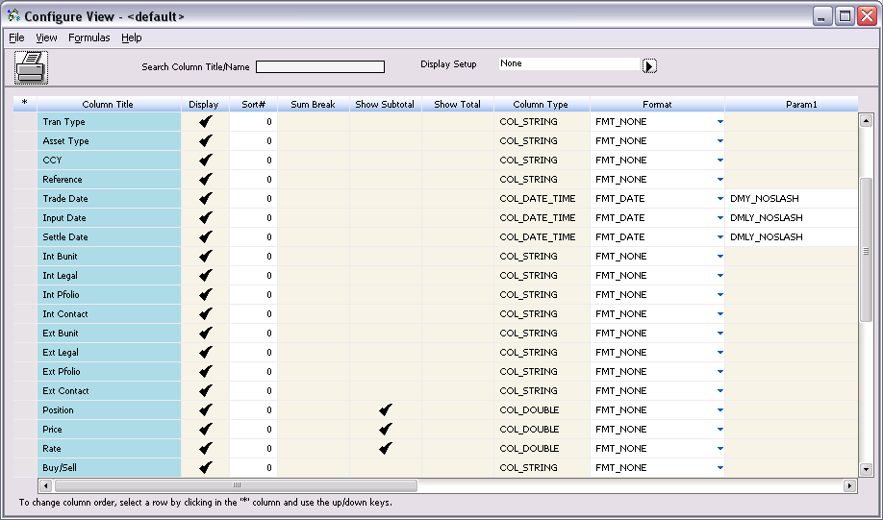
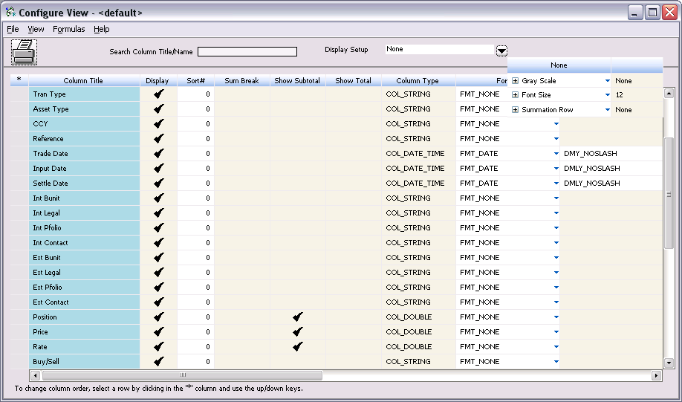
Table Viewer Configuration
Notes:
Group, sub-total and format the table to meet their viewing requirements.
Note that only numeric fields may be summed or totaled by group.
Modifications to the Configure View window may be saved as the default and applied each time the window is opened.

Slide 31
Any Questions ?

Slide 32
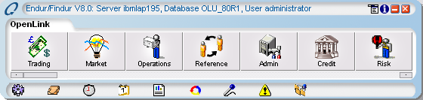
Admin Manager
Notes:
Any questions
Now going to discuss static data and Transportation Network
Introduce key concepts & terminology

Slide 33
Admin Manager
Performs multiple administrative tasks:
System configuration
Maintenance of static data
Security privileges
Data Model Extension
Notes:
used to set up and configure system and user defaults
establish user security access.
Maintain Static data
Data Modelling
This configuration process is typically done during implementation. Once system configuration has been completed, users or system administrators would only access these functions to make modifications or updates to the original configurations.

Slide 34
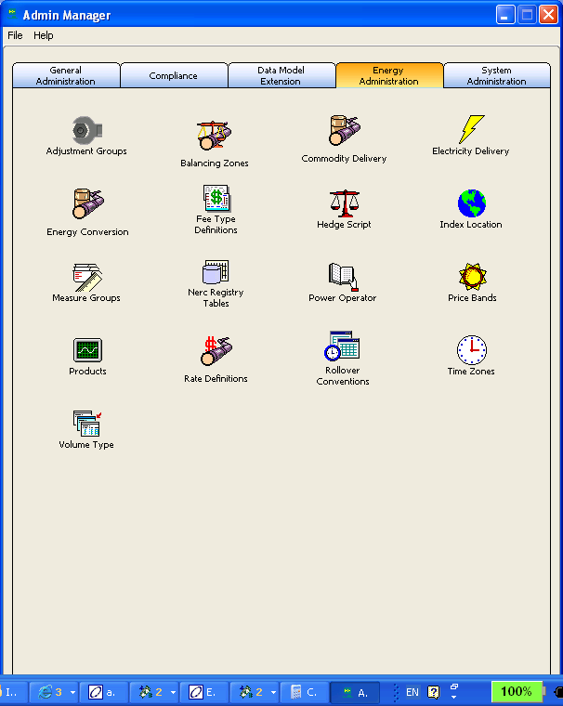
Admin Manager

Slide 35
Admin Manager
General Administration | Contains links to the general tasks used to set up Endur .
Compliance | Contains compliance related tasks, such as Security Groups and Activity Audit .
Data Model Extension | Used to create fields beyond those stored in the base system .
Energy Administration | Tasks specific to the energy industry such as pipelines, locations, zones, products, and time zones. Note: This section is covered in a separate document entitled Energy Administration.
System Administration | System Administration tasks such as auto start-up
Notes:
Admin Manager Tab Descriptions
Although not all features may be presented in the training class, this training workbook discusses the more commonly used Administration functions in the General Administration, Security/System Administration, and Data Model Extension tabs.

Slide 36
Admin Manager General Administration
Broadcast Channel
Date Sequence
Portfolio Groups
Printer Set-up
Purge Configuration
Static Data
System Wide Configuration
Unit conversion
Notes:
Broadcast Channel - Create channels through which the different system users can communicate.
Date Sequence - Create, view, and modify customized date sequences to establish “good trade days” within the system. A date sequence is a periodic sequence of dates generated by formulas as defined by system users. Modifying date sequences impacts market indexes and system pricing. Lets see page 6
Portfolio Groups - Portfolio Groups facilitate the authorization of instruments. Instruments are authorized for specific portfolio groups. When a new portfolio is added to a portfolio group, it may trade the instruments authorized for that portfolio group.
Printer Set-up - Users may set default printers which system generated reports and other files will print to.
Purge Configuration - designed to enable clients to maintain as much or as little data necessary to meet their business needs.
Static Data - allows users to view and set up pick lists within the system. Lets see page 9
System Wide Configuration - allows a user to configure the environment variables for each user.
Unit conversion - converts units of weight, measure, or amounts. For example, gallons may be converted to barrels and vice versa. Both the units and the conversion rates are set up in the Admin Manager. Units are used in market price curves (projection indexes). Lets see page 12

Slide 37
Admin Manager Compliance
Activity Audit
Error Log & Console Viewer
Password Modification
Security Groups
System Shutdown
Notes:
Activity Audit - allows administrators to log and view all activities performed in the System by its users.
Error Log & Console Viewer - allows users to track errors encountered while using Endur. This module is helpful in troubleshooting technical problems.
Password Modification – allows users to modify and expire passwords.
Security Groups – Maintains users’ access to system features and functions. Lets see page 21.
System Shutdown - allows authorized users to shut down the system.

Slide 38
Admin Manager Data Model Extension
Adhoc Query
Index Info
Instrument Builder/Tran Info
Password Modification
Security Groups
System Shutdown
Notes:
Adhoc Query - displays system data or user data, stored in database tables. It also shows the structure of the tables, including key fields and indexes.
Index Info - user-defined fields that feed to the Market Manager. They may apply to all curves types or specific markets.
Instrument Builder - allows authorized users to create customized reference fields for use with trades. These new fields may be used on a transaction or on an instrument basis.
Tran Info Fields - define custom field labels for specific instruments and toolsets
Tran Field Notifications - add custom logic on specified fields on a transaction
User Defined Instruments - define your own instrument type
User Defined Events - create a custom event
Operation Services - Customize the processing of transactions.
Let’s see page 26.

Slide 39
Admin Manager Transportation Network
??

Slide 40
Reference Manager

Slide 41
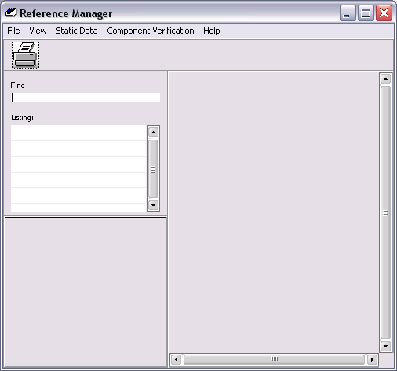
Reference Manager
Parties
Portfolio
Personnel
Notes:
1 Party - Represents the internal groups within your organization and the external ones such as counterparties or brokers
2 Personnel - Employees within a party
3 Portfolios - Books which the internal parties trade for.

Slide 42
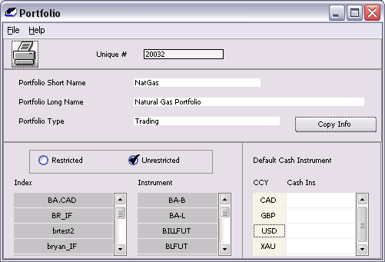
Reference Manager Portfolios
Portfolios – The trader’s “book” structure.
Notes:
Portfolios represent a Trader’s “book” structure. Once portfolios are created, they are linked to both personnel and the Business Unit and Legal Entity of the Party Group. Let’s see page 2.

Slide 43
Reference Manager Personnel
Personnel - users in the system.
Contacts in counterparty organizations
E.G.: broker contacts
External
Contacts in your Organisation (Non-System users)
Internal
E.G.: Admin Staff/Manager
Contacts in your Organisation (Authorized System users)
Licensed user
E.G.: Traders
Notes:
The next step in the trading process is to grant personnel access to trade within the party groups and portfolios. There are three types of users in the system: external, internal and licensed users.

Slide 44
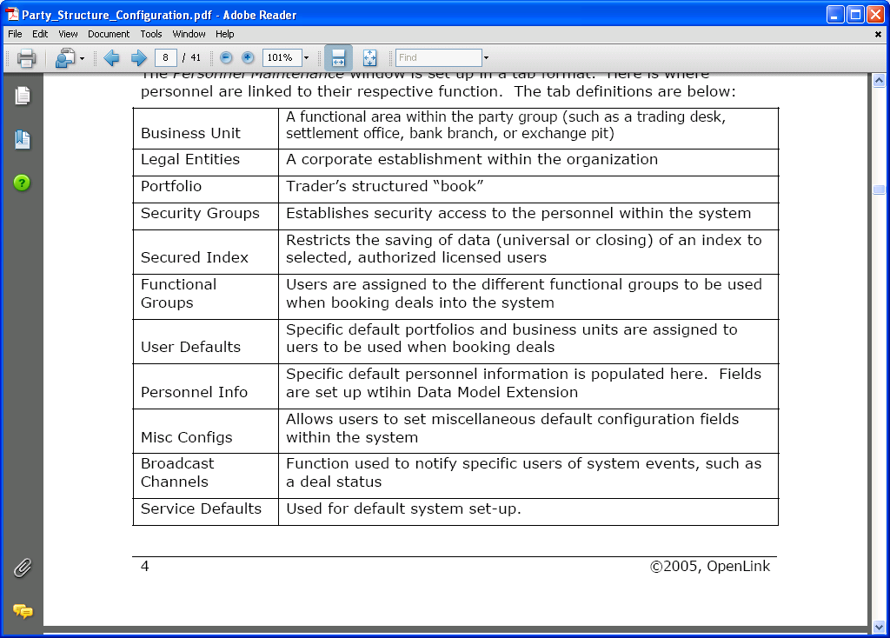
Reference Manager Personnel

Slide 45
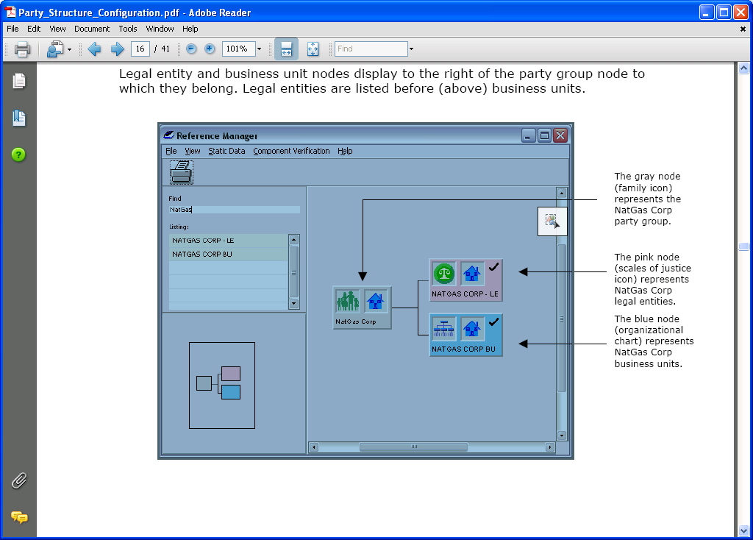
Reference Manager Party Group
A corporate structure is a “party group” in the system.
Legal entities
Business units.
Notes:
Party Group - Represents the entire corporate structure. It is the parent of the legal entities and business units. Party Groups are created individually within the system. They can be internal or external. The internal party group is the structure of your organization while external party groups might be counterparties or brokers. Party groups are made up of :
Legal Entity - Handles the legal aspects of the organization, such as contractual obligations and party agreements.
Business Unit - Represents the functional area of the party group (such as a trading desk, settlement office, bank branch, or exchange pit).
Let’s see page 13. Please note that a default BU & LE is automatically created when creating a Party group if the ‘Create Default BU & LE’ option is selected.

Slide 46
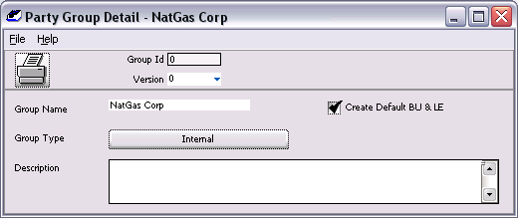
Reference Manager Party Group

Slide 47
Party Group - Required Party Information
An Account - to be used for trading.
Settlement Instructions - Tells the system how to settle each instrument in the currency or commodity traded.
Party Agreement and Agreement Conditions - created and maintained within the Legal Entity to determine the terms of the trades that will be booked by the party.
Notes:
In order for trading to occur, several pieces of information must be established within the Party Group. Each one of these components will be linked to the Party Group:
Creating a Account
Creating Settlement Instructions
Creating a Party Agreement and Agreement Conditions
Let’s see pages 14-20

Slide 48
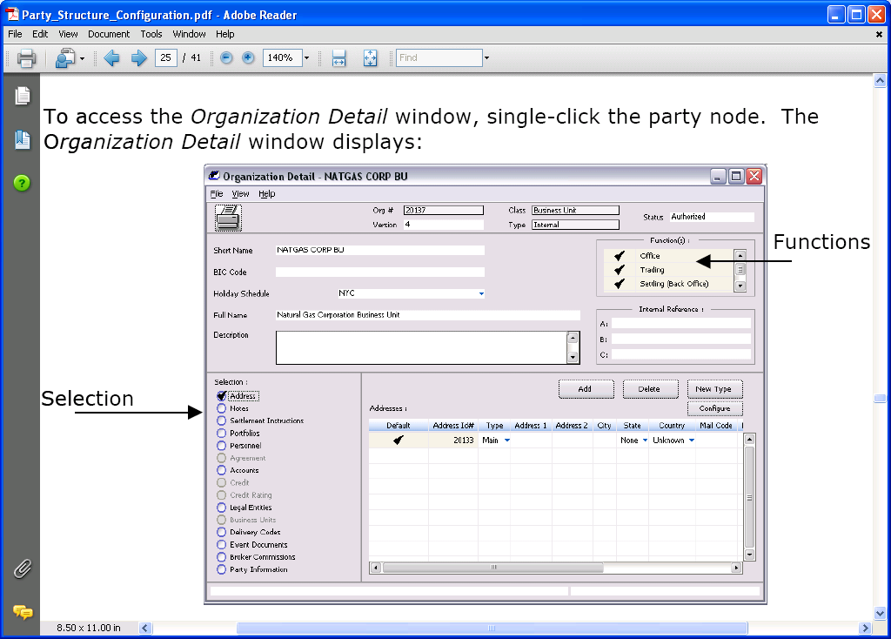
Party Group Business Unit
Notes:
The Business Unit is the functional areas within a firm, such as a trading desk, settlement office, bank branch, or exchange pit. The business unit must be Linked or assigned to settlement instructions, accounts, portfolio information, business unit personnel, legal entity, third party delivery codes, and events documents.
Address
Notes
Settlement Instructions
Portfolios
Authorized users
Accounts
Legal entities
Third party delivery codes
Broker Commissions
Let’s see page 21

Slide 49
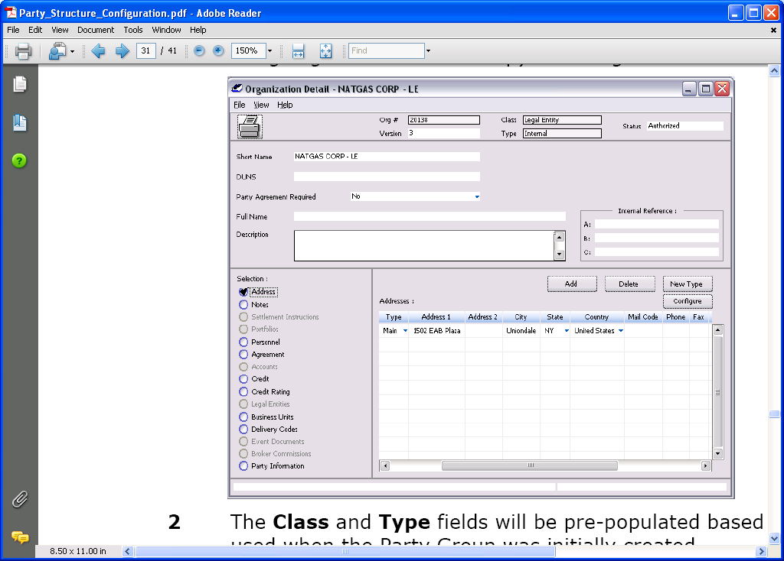
Party Group Legal Entity
Contractual obligations of the Party Group
Notes:
The Legal Entity handles the contractual obligations of the Party Group.
Address
Notes
Personnel
Party Agreement
Credit Information
Credit Rating
Business units
Delivery code
Party information
Lets see page 27

Slide 50
Party Group Party Agreements

Slide 51

Market Manager
Notes:
Any questions
Now going to discuss each area of the system relevant to accounting in more detail
Introduce key concepts & terminology
Starting with trading manager

Slide 52
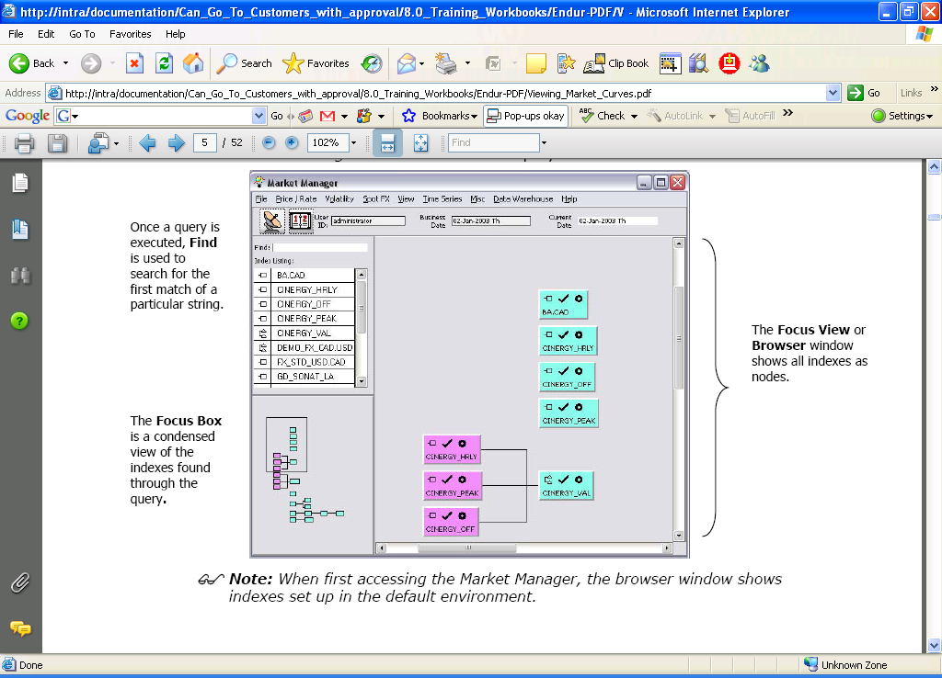
Market Manager
Define, modify, and view prices, rates, volatilities, and correlations.
Indexes/Curves
Grid point represents a price or rate for different time periods.
Grid points on a Spot FX curve represents currencies.
Prices, Rates etc can be obtained from market feeds, entered manually, or calculated via internal or user-supplied logic.
Notes:
Market Manager - is used to define, modify, and view prices, rates, volatilities, and correlations. It contains index, or curve, definitions used in the system.
Curves are composed of grid points. Each grid point represents a price or rate for different time periods.
Indexes are composed of grid points, prices, or rates for different time periods (with the exception of the Spot FX curve where the grid points represent currencies). These items can be obtained from market feeds entered manually, or calculated via internal or user-supplied logic.
Let’s see page 2 of our workbook for how to load Indexes and what the symbols/colour conventions mean.

Slide 53
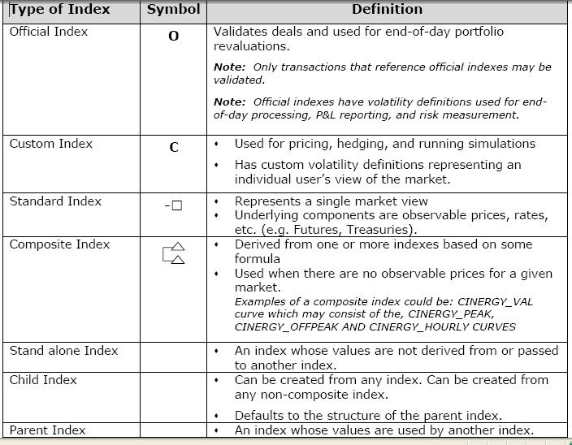
Market Manager Indexes
TYPES OF INDEXES
Notes:
Indexes - holds prices, rates and other information. They are used to price deals.
Indexes must have three or more grid points associated with them; the only exceptions to this rule are composite indexes (which do not contain grid points).
For example, an “O/N” grid point represents the over night rate or price. For certain markets such as Natural Gas, date sequences may be used to set up grid points. Date sequences are set up in the Admin Manager as discussed earlier.

Slide 54
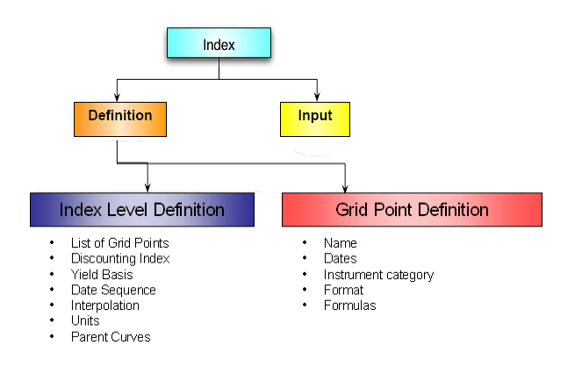
Market Manager Indexes

Slide 55
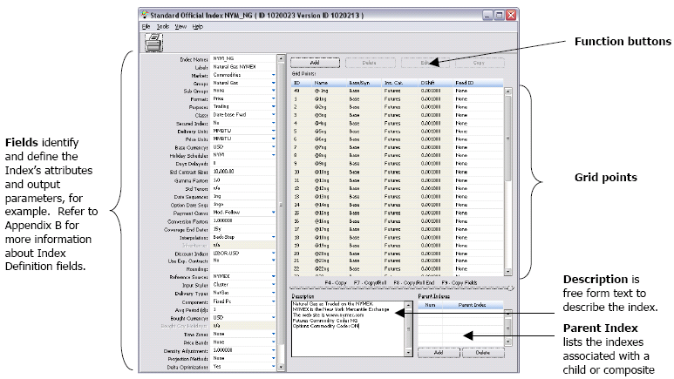
Index Definition
Notes:
Index definitions - specify relevant attributes of market indexes, used to structure instruments and deals. Two levels – Index level definition and Grid points definition (prices for points in time).
Indexes are defined in the Standard Official/Custom Index window. Please note that there are two ways of creating an Index:
Copy and modify an existing Index
Define a new one from the Index definition window
Let’s see page 7

Slide 56
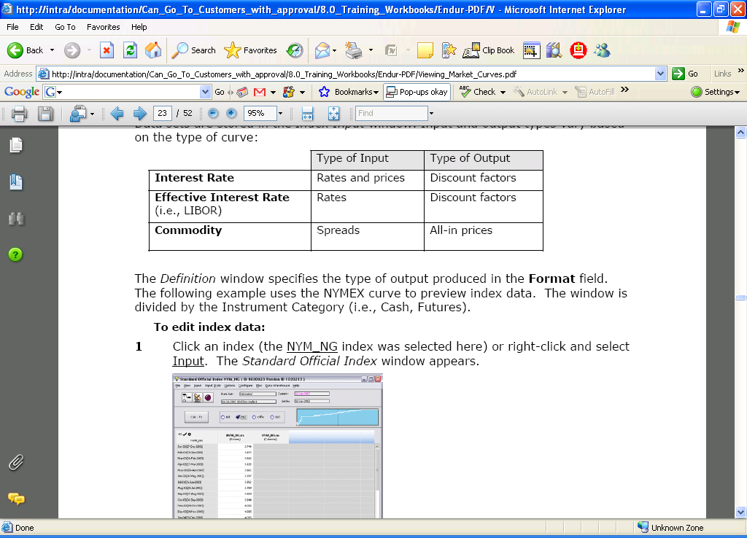
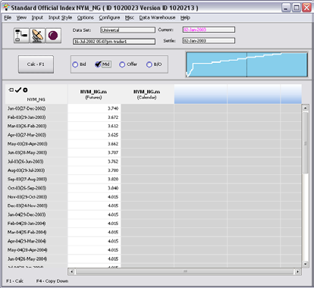
Index Input
Data sets are stored in the Index Input window. Input and output types vary based on the type of curve
Input/Output types
Notes:
Data sets, market rates or prices for a standard index (or a user’s view of the market for a custom index) are displayed in the Index Input window. Once a curve is created, the Input Window data can be saved in different forms: Universal, Close, Personal and Historical.
Let’s see page 19

Slide 57
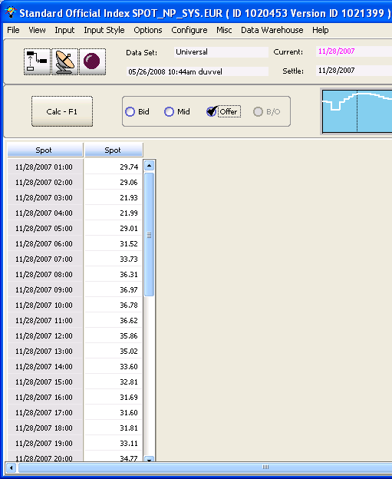
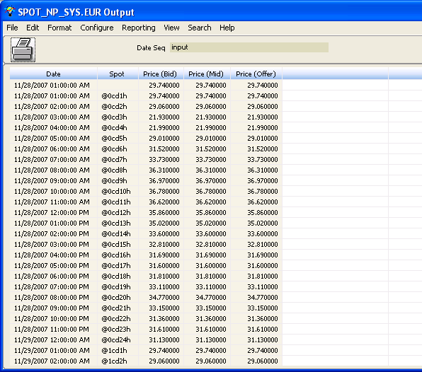
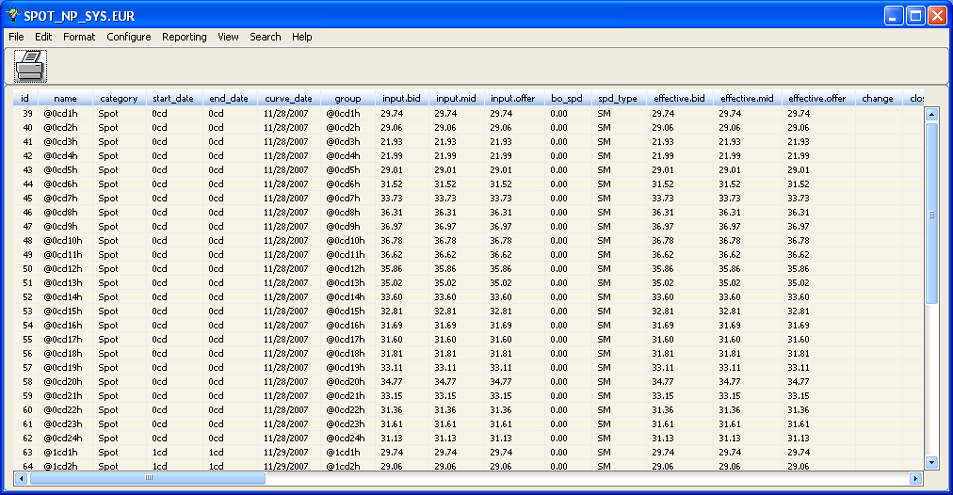
Market Manager Viewing and Saving Prices
Notes:
Data set input displays the grid point dates and marks the activated ones. The output displays the grid point’s rate/price using the calculation specified in the definition.
To view the input or output of a data set:
Select View from the Standard Official Index window menu bar and choose the appropriate sub-menu item:
• Output: Rates or discount factors (as defined in the Definition window)
• Grid Point Data: List of grid point input and definition information
Graph: A pictorial representation of the output over the time period specified (The x-axis represents the month/year and the y-axis represents the market rates/prices).
Let’s see page 20

Slide 58
Overview of Endur Trading Manager

Slide 59
Trading Manager
Captures deals
Retrieve & view existing trades
Run & view reports
Performs on-the-fly simulations
Revalue portfolios
Notes:
Trading manager is used for capturing trades

Slide 60
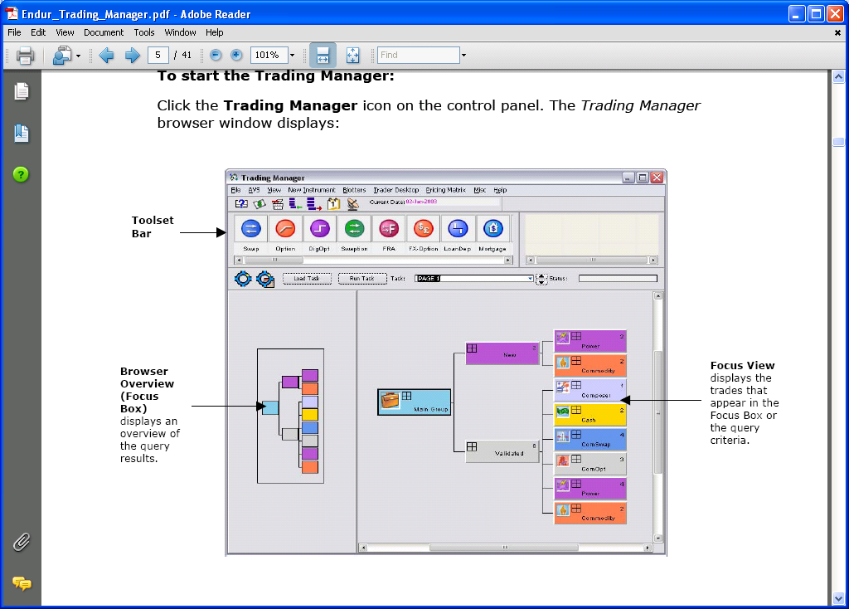
Trading Manager Browser

Slide 61
Trade Numbering
Each trade has specific identification numbers and dates assigned to it
Toolsets
Instrument Number
Instruments
Transactions
Transaction Number
Deal Number
Notes:
A deal has:
Instrument number – Relates to the instrument type.
Deal Number – Remains constant
Transaction Number – Changes when the deal is modified and saved

Slide 62
Trade Dates
Input Date
Deal
Trade Date
Notes:
Both the Input Date and Trade Date are recorded for each transaction:
Input Date - Generated by the system. Cannot be modified by the user.
Trade Date Is the date the trade occurred. Defaults to the Input Date but can be modified.

Slide 63
Trading Platform
Browser window
Trading query
Customisable browser
Trade key concepts:
Numbers
Instrument
Deal
Transaction
Dates
Input
Trade
Notes:
Consists of a browser window interface
Provides query tool for retrieving trades
Customisable browser desktop to view trades
Trade information consists of
Numbers
Instrument – relates to instrument type
Deal – unique number assigned to deal – does not change
Tran – transaction number, can change through deal’s life cycle
Dates
Input – system generated date when trade entered
Trade – date trade occurred – defaults to input date but can be changed
Settlement – date on which settlement occurs (mainly related to financial toolsets)

Slide 64
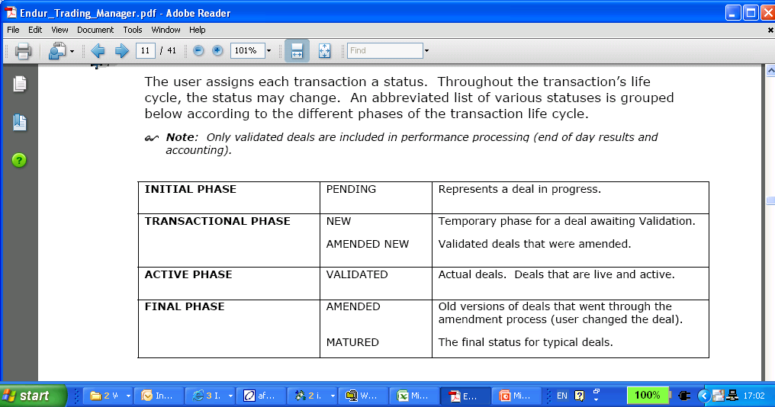
Transaction Lifecycle
Notes:
Transaction life cycle
Deals commence life with status of pending, no events associated with the transaction
Trade can be processed to status of new, and is given a deal and transaction num at this stage, however still not a ‘live’ trade and can be altered without affecting any processing events
Trade can then be validated – transaction events now become associated with it – any alterations will create new tran num.
Matured trades indicate the deal is complete and there are no more events for it.

Slide 65
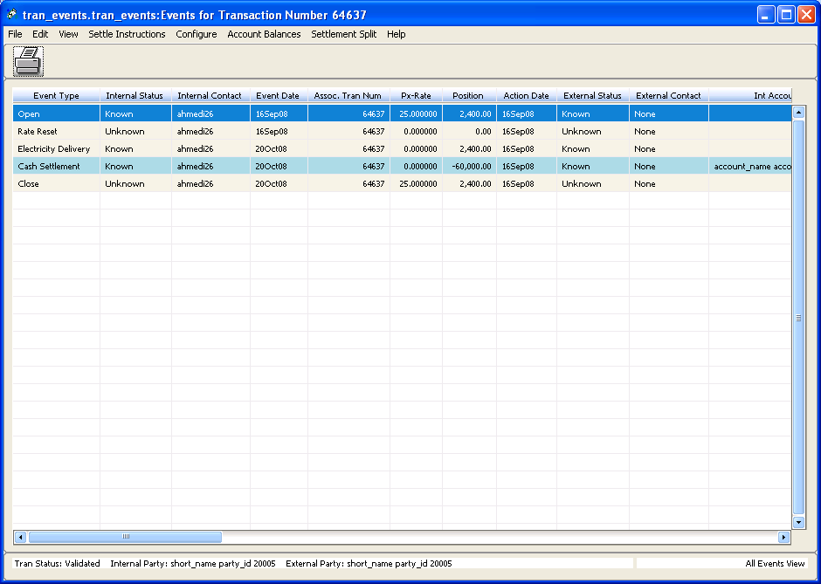
Trade Events
Generated when deals are booked to Validated status
Represent a roadmap operating on the deal
Notes:
All trades have exactly one "Open" type event. The exact Open type event depends on how the trade was processed to its current status.
The "Open" type event will have an "Event Date" equal to the current date of the system when the deal was booked.

Slide 66
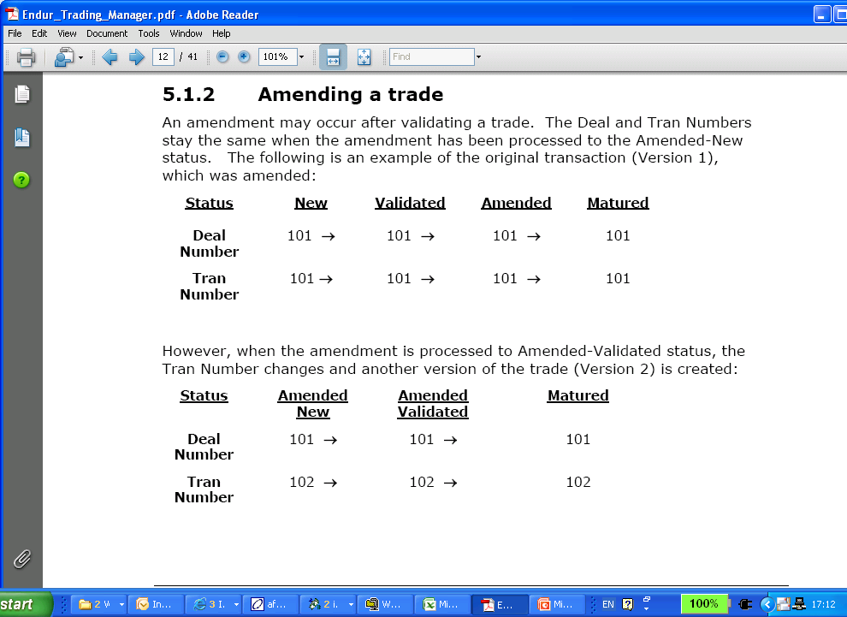
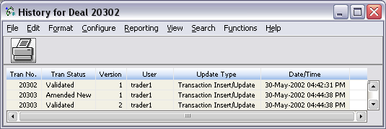
Trade Numbering

Slide 67
Power Trading
Products - defines the days and hours, including holidays, in which electricity will be delivered
Custom
Full requirement
Hourly Products

Slide 68
Price Bands, Power Products, Power Curves and Delivery Locations
Peak
Power Curves
Price Bands
Valuation Curve
Off-Peak
Hourly
Power Product
Deal
Valuation product
Delivery Locations
Notes:
Each power-pricing curve has a price band. Price bands are client-defined, and represent different price categories of power (e.g., peak, off-peak, etc.). The valuation curve includes the Peak, Off-Peak and Hourly power price curves.
Price bands are also used to build the power products. The valuation product is a twenty-four hour a day, seven day a week matrix that has a price band defined for every hour.
The electricity delivery location is linked to a valuation index and a valuation product. The power product, electricity delivery location and valuation curve are components of the deal.

Slide 69
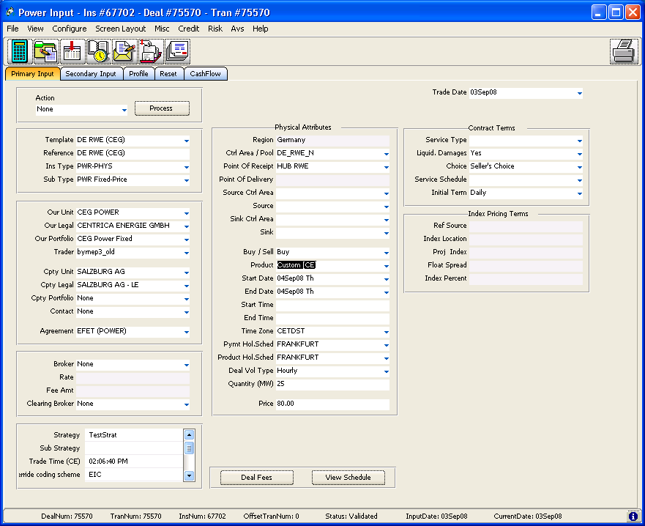
Deal Entry in the Power Toolset
Notes:
A variety of power trades can be captured using the power toolset:
Physical Power deals
Power options
Power swaps
The Input Screen
Primary Input – Main Fields used in the toolset. Contains deal information
Secondary Input – Transaction level information
Profile – Information relating to how payments are calculated, view cash payments and scheduled delivery dates.
Reset – Reset Dates and rates for floating side of the deal (Rates from the associated curve/index)
Cashflow – Miscellaneous cashflows associated with the transaction
This section is very interactive.
Let’s turn to page 2 of our workbook.

Slide 70
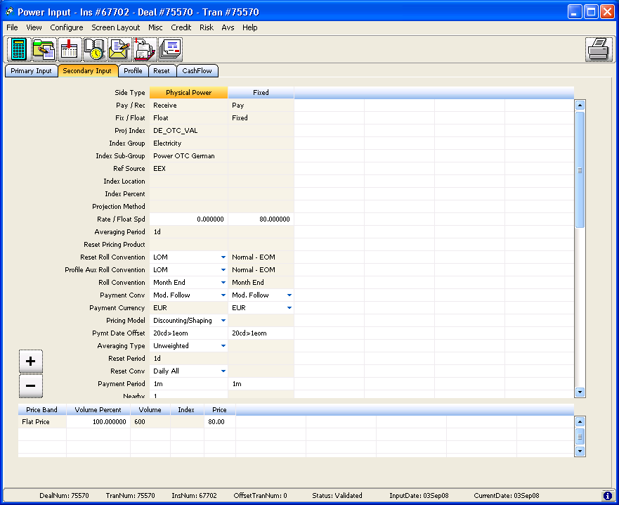
Deal Entry – Secondary Input

Slide 71
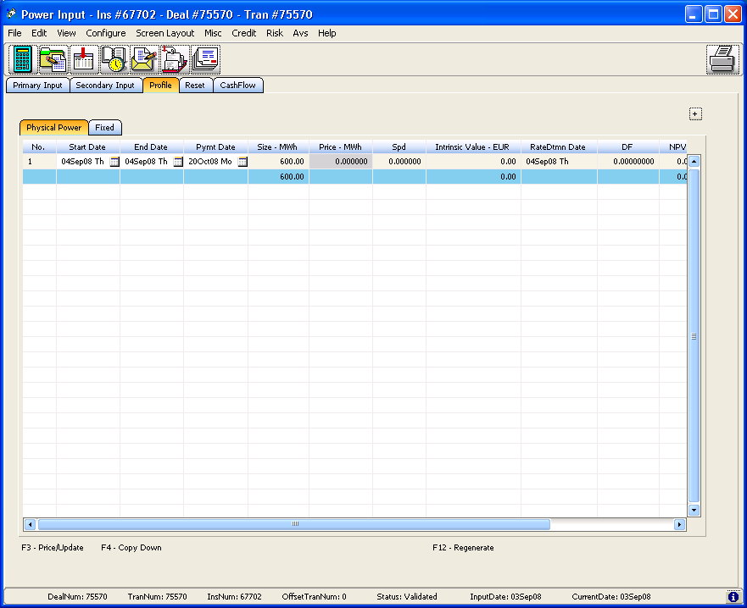
Deal Entry – Deal Profile – Physical side

Slide 72
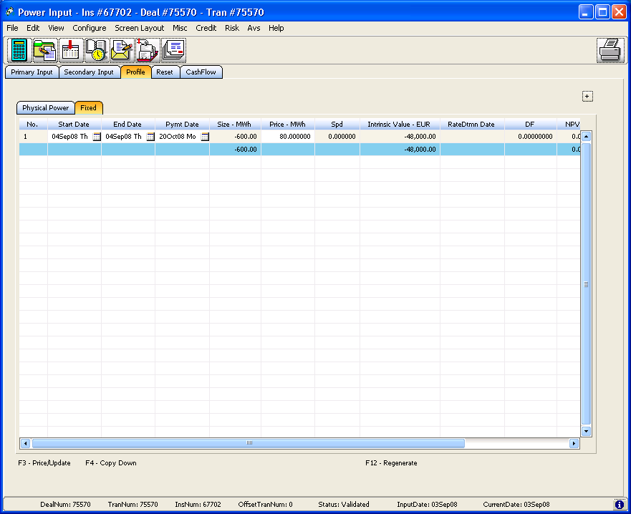
Deal Entry – Deal Profile – Fixed Side

Slide 73
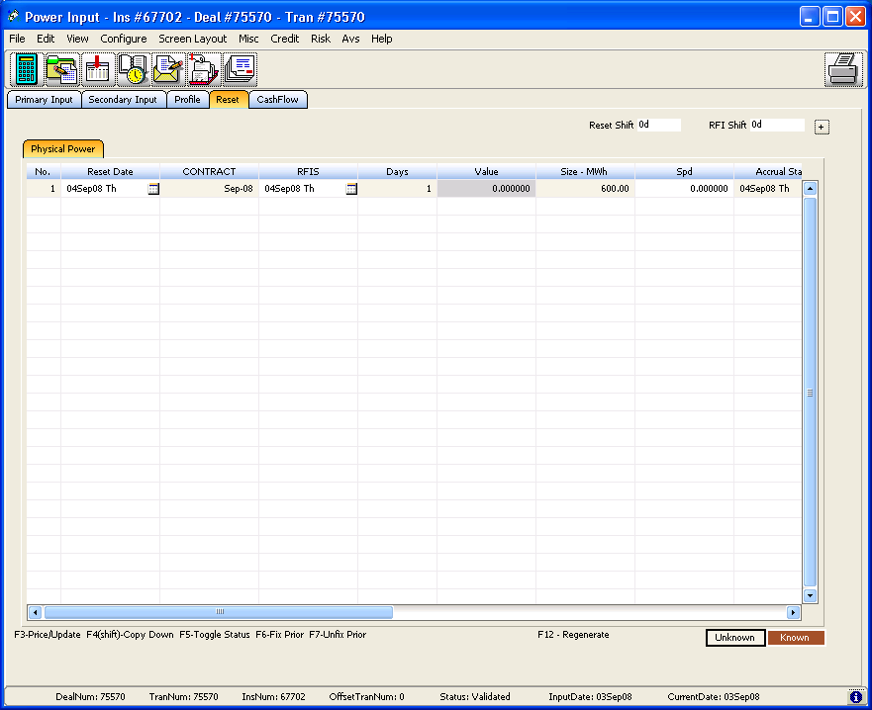
Deal Entry – Reset – Physical Side

Slide 74

Deal Entry – Reset – Physical Side - Priced

Slide 75
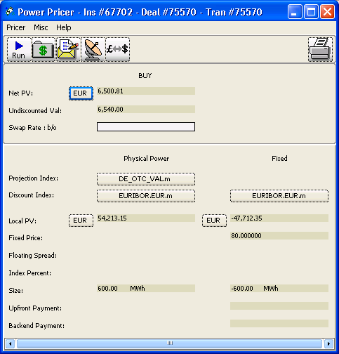
Price the Deal
NPV
Physical Side + Fixed Side
Notes:
Let’s turn to page 4 of our workbook.
We will look at how the system arrived at these calculations

Slide 76
Pricing the Fixed Side of the deal

Slide 77
Pricing the Physical Side of the deal

Slide 78
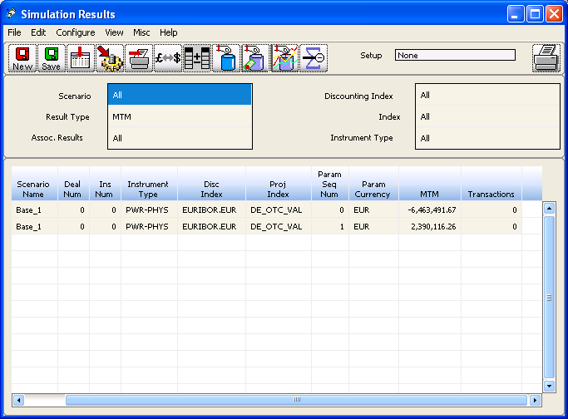
Modify the deal
Modify the Deal
Note the changes to Value of the Deal
Run a Simulation:
Notes:
Notice how changes to Volume and price affects the NPV
What do you have to change to break-even on your deal?

Slide 79
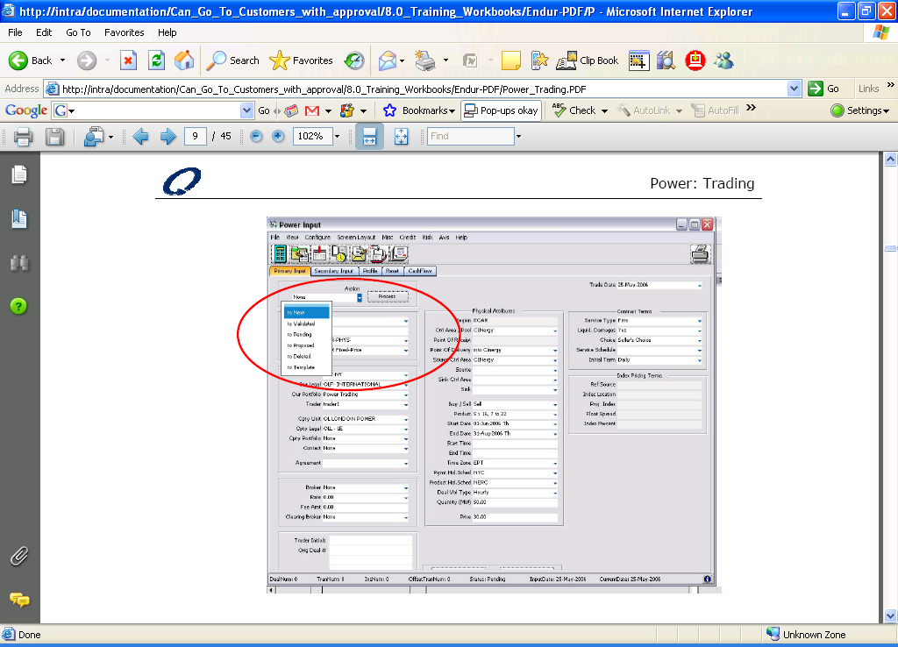
Validate the Deal

Slide 80

Portfolio Revaluations
Simulations are a list of results for pricing, valuing & accounting for transactions
Run simulations against transactions
Can be run on-the-fly or as part of EOD
Accrued interest calculations
Cash settlements
MTM
Realised PNL

Slide 81
Trade Entry
TOOLSETS
Represents a specific market / Group of similar instruments
Enter one deal at a time
Multiple fields of information
TRADER DESKTOP
Generic or for a specific instrument
Enter multiple deals at a time
User configurable (fields, columns, and push buttons)
Can enter default values
Notes:
Trade entry – toolset
For a specific instrument or type of deal
Only one deal at a time can be entered
Allows entry of multiple fields
Default values can be entered
Trade entry – Trader desktop
Generic or a specific instrument or type of deal
Multiple deals can be entered at once
User configurable
Default values can be entered

Slide 82
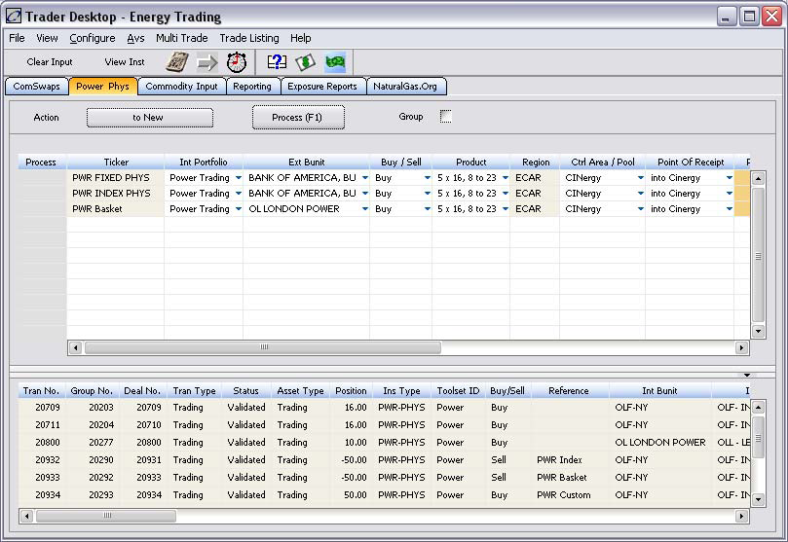
Trader Desktop
Notes:
Power deals can be entered through the Trader Desktop as well as the Trade Blotter. Below we will configure a power physical deal entry panel for the Trader Desktop.
Now lets turn to Page 37 of our workbook
Power Physical deals can now be processed via the Trader Desktop. The templates display on the upper portion of the screen and allow for deal entry.
The lower portion of the screen displays the trades that match the criteria as defined in the query we selected during configuration.

Slide 83
Recap & Questions ?

Slide 84
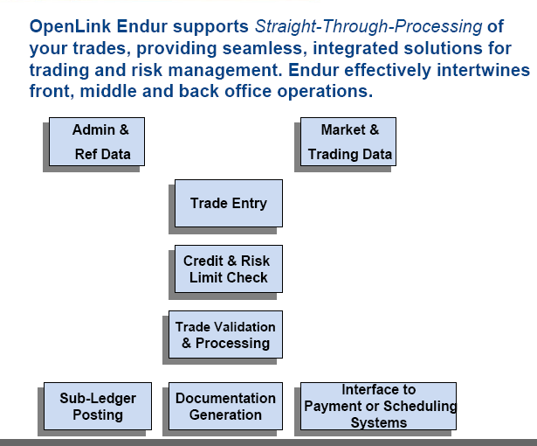
The Lifecycle of a Trade

Slide 85
Endur Managers
Admin Manager:
Global administrative data (i.e., static data maintenance, security privileges, network grids)
Reference Manager:
Counterparty and internal entities’ information, personnel, broker fees structure, agreements, settlement terms
Trading Manager:
Trade Blotter
(Deal Entry)
Trading Manager:
Master instrument - sharable toolset, templates - unique toolset
Market Manager:
Market curves and volatilities, historical prices
Commit to a preliminary status
Credit Manager:
Credit check (credit line & credit rating)
Risk Manager:
Market risk check (risk lines)
Back office validation
“Validation”
of
Deal Terms
Operations Manager:
Events generated
Accounting Manager:
P&L
Confirm
Settle
Rate fixings
Reset Notifications
Matured
Notes:
Endur Managers Represents functions that you can perform within the system.
Trading Manager
Master instruments
Sharables
Trade entry blotters/Trader Desktop
Templates for uniques
Admin Manager
Global system set-up
Static data maintenance
Security privileges Client Data modelling – Tran Info, Ins Info, Party Info, Personnel Info
Reference Manager
Book structure – info, broker fee structure, settlement terms, agreements, etc
Personnel – portfolios, security privileges
Credit & Risk Managers
Check counterparty credit limit
Market risk e.g. MTM, trader limits
Operations Manager
Mini-modules controlling transaction events

